Slide 1
Collections in Java
COURSE OVERVIEW

Slide 5
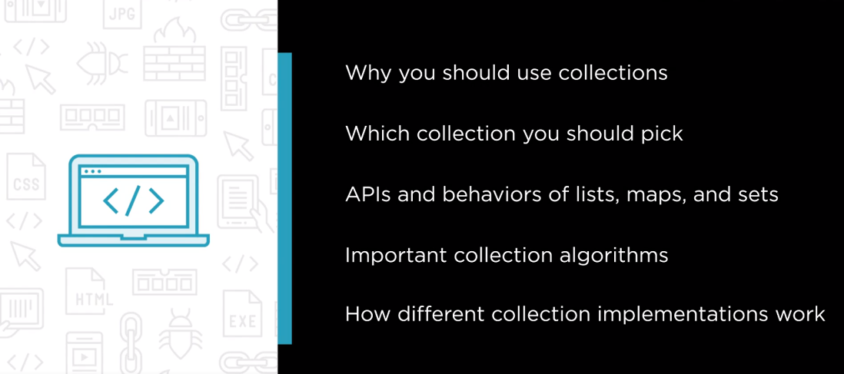

Slide 6
